Slide 1

Data Analytical Platforms

Slide 2
Before we begin…..
What is an OLTP system
What is Normalization
What is De-Normalization
What is an application layer and data layer?
Where all you get data in an enterprise?

Slide 3
Users in an Enterprises
Synonyms for Analytical Platforms in today’s world
(OLAP)
Data Warehouse
Data Marts
Data Lake
Strategic Decision – change in direction of company, M&A (buying other companies)
CXO
5% of people are Executives
Tactical Decision
(yes and no)
Some times yes
Some times no
Head of Operations
25% of people are managerial users
Operational
Decision
(system driven
OLTP)
Others
CRM
VMS
SCM
70% of people are operational
users
HRMS
FINANCE
PRODUCTS

Slide 4
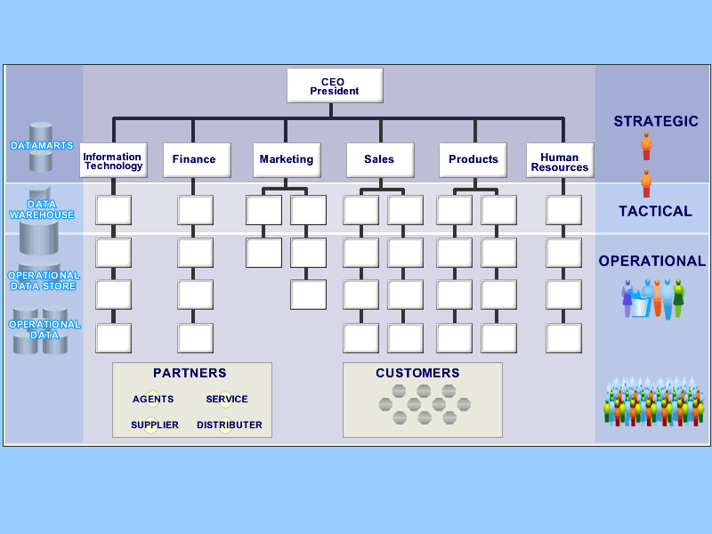
Data Analytical Platforms
Reporting for MIS
EDW / DM / ODS
Master Data Management
Data Lake
OLTP Systems
(Operations)
ERP
Web Apps
Mobile Apps
iOT
Legacy
API Interfaces

Slide 5
Analytical Systems / Data Platforms
If you think about the activities which goes in the following business, you will come to know the objective of the Data platforms in any company.
R & D Department of a Car Manufacturing Company
Collect what we have NOW & Find the pain points ( can be Design, Fuel consumption, Maintenance)
Re design the components, look, create a mock, validate, test under the known and unknown conditions and make it ready for Production
Consolidate all the different line of businesses in a bank (retail, loan, credit cards, investments)
Provide single version of customer across all different perspectives (CTV – KPI)
Pull data from loan + investment + credit ➔ add using your formula → value (50,000)
Integration of data from multiple systems (data engineer – analyse the source, find the common column, interate – enterprise view)
KPI – we need enterprise wise data (not just operational data)
Cibil – is the kpi which decides how much loan amount they can distribute (rbi +finance ministry)
Identify the deploy time series analysis (time line of anything business do). – viewing revenue / profit based on month / quarter / year
Consolidation + integration + transformation (USD to INR / GBP to INR / SR to INR)
Provide regulation reporting from the consolidated data as per the compliance. (reg reporting)
Complete Health Check up Scenario(When do we do this?)
Do you go to complete health check up when you are in teen or when you cross 40 + of age? At what age your doctor recommend to go for complete check up and why?
I don’t want to be a burden for my family members or I love my work, I cannot miss that etc.

Slide 6
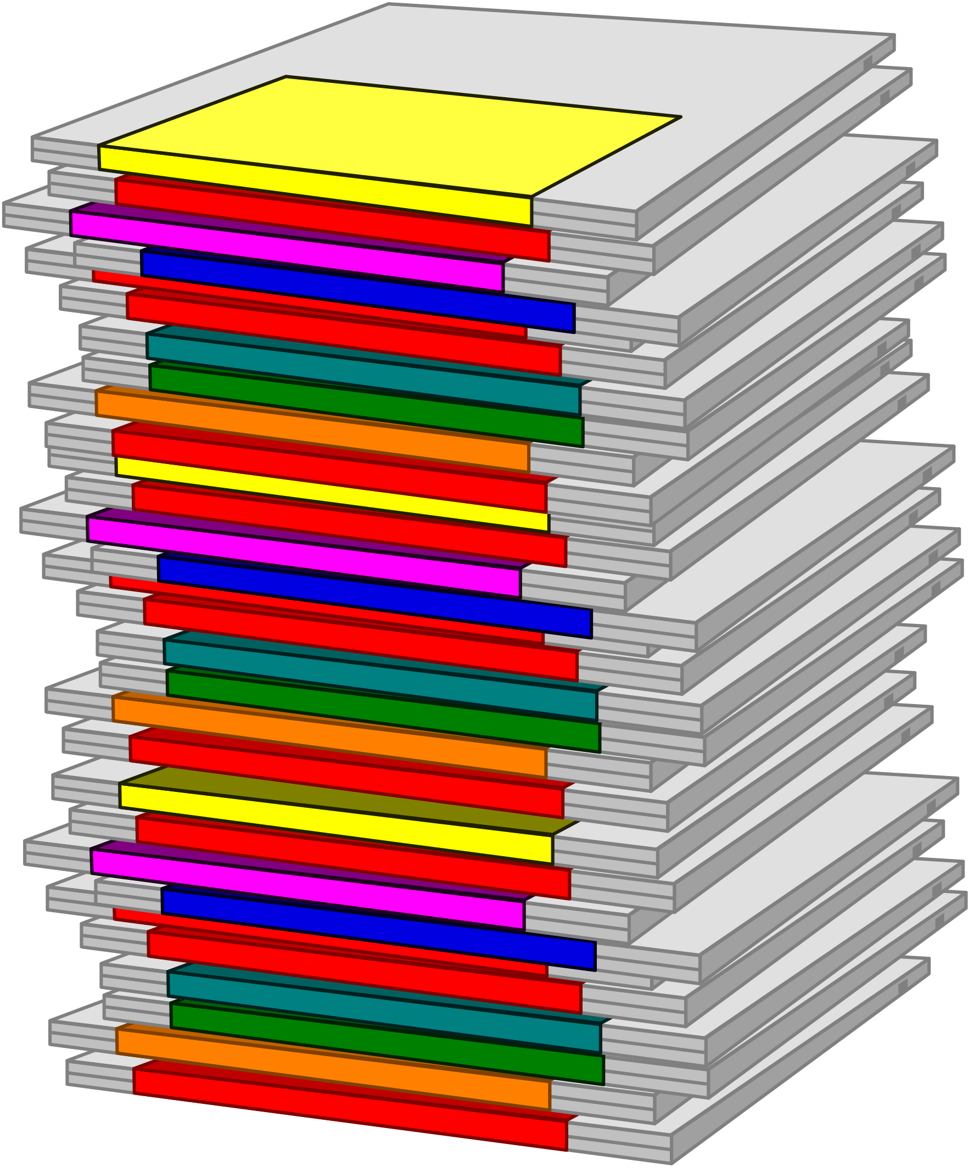

What is a Data Warehouse (definition)
Information
A single, complete and consistent store of data obtained from a variety of different sources made available to end users in what they can understand and use in a business context.
[Barry Devlin]
A process of transforming data into information and making it available to users in a timely enough manner to make a difference
[Forrester Research]
Data

Slide 7
Typical problems without DW
I can’t find the data I need
data is scattered over the network
many versions, subtle differences
I can’t get the data I need
need an expert to get the data
I can’t understand the data I found
available data poorly documented
I can’t use the data I found
results are unexpected
data needs to be transformed from one form to other

Slide 8
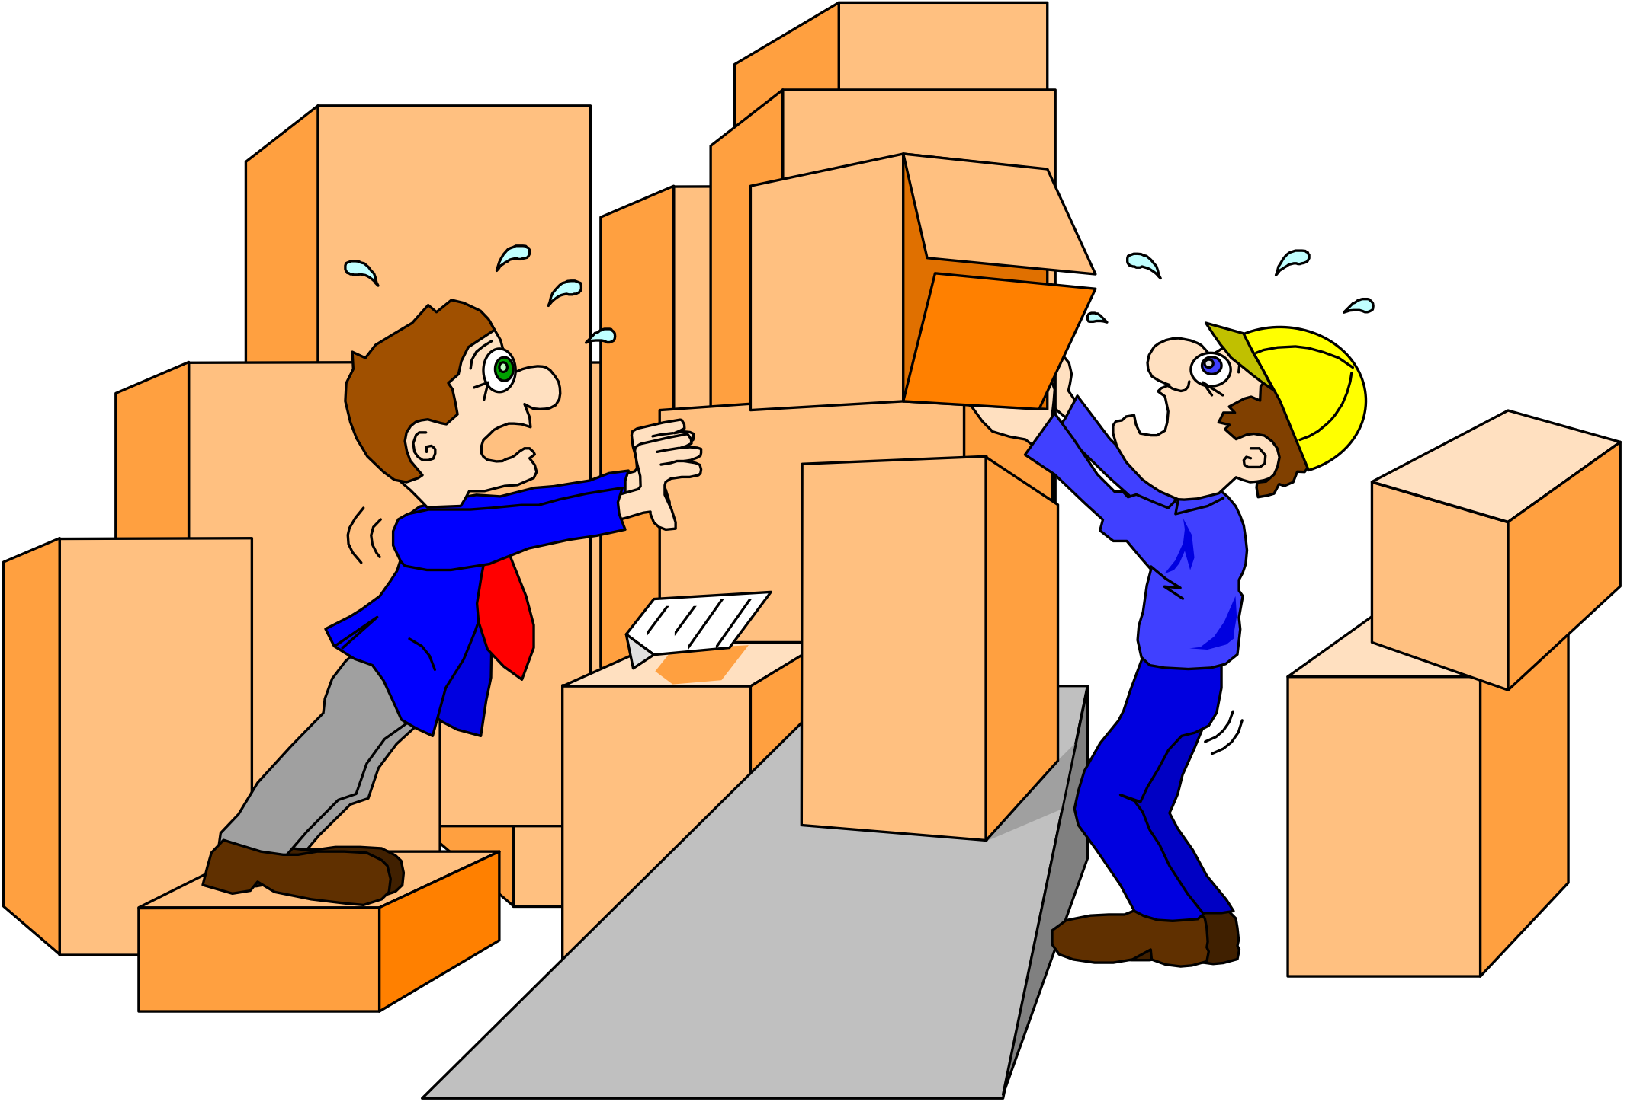
What management wants?
Data should be integrated across the enterprise.
Typically Data engineers job is to analyse the different sources and integrate the data based on the enterprise perspective.
Summary data has a real value to the organization.
Most of the tactical decisions and strategic decisions are taken using aggregate value. If more than 50% percent of customers rating is bad, then we have to work on improving customer satisfaction. (not based on one customer view)
Historical data holds the key to understanding data over time.
Key to know the BEFORE and AFTER analysis. Before customer used to be in MUMBAI, the sales value is say 50000, now customer lives in BANGALORE, sales value is only 30000. What parameters are forcing this change?
What-if capabilities are required.
If we remove two products from a product line, what is the impact on the revenue, what is the impact on the store space and what’s the impact on the employees.

Slide 9
Analysis View from Managers & Above
User Roles
Business Line
Retail (POS, SCM, INVENTORY, eCOM)
Healthcare (OPD, In Patient, Asset , Clinical, preventive health)
Industry 4.0 (SCM, Service, Plant Management, Distribution, inventory)
Logistics (orders, shipments, delivery, warehouse and fleet management)
Fintech (wealth creation, loan management, banking, payments )
KPI’s
(Measures)
Perspectives
(Customer, Service, Support etc)
Time
Line
World of Analysis
Viewing Metrics / Measures based on different perspectives (Dimensions)
Analysing Sales Revenue by Customer Segment
Analysing Sales Revenue by Time Period Analysing Sales Revenue by Product Line Analysing Sales Revenue by Location Analysing Sales Revenue by Payment Type
Analysing Sales Revenue by Channel (Shop, Online, TV, Call Centre)
In this case, Sales Revenue is the FACT / MEASURE and Customer Segment, Time, Product, Location.. are dimensions
Horizontal Opportunity
HRMS
CRM
Finance
Social media
SALES
SUPPORT

Slide 10
OLTP (Operational) Vs OLAP (Analysis)
Typically we don’t change the data in DW (less or no updates and deletes)
Queries based on time period, set of products, set of customers etc (Range Queries)
We typically store 3+ years of data (for analysis)
We track the changes in the DW as part of historical management.
Used mainly for analytics (trend analysis, customer behavior etc)
De-normalization / Dimensional Model is the way design the DW storage
More DML operations (Update, Delete, Inserts)
Point Queries (usually we go to database based on the PK or FK to get data)
Very specific while issuing queries
We typically store 2 years to 3 years in operational systems
Used for day today activities (must to run the business). We don't (except for audit) store changes in the operational systems.
Focus to implement the operations part of the business.
Follow the 3rd normal form data modeling to create the model.

Slide 11
Analysis (Data Platform Stage)
What happened? (static report)
Why it happened? (Ad hoc reports)
What If Analysis? (what may be the impact if an event happens)
What will happen? (ML – Python, SAS, SPSS, R, Matlib, H2O)
Real Time Analytics and Responses (What’s happening & automation of Decisions)

Slide 12
Analysis (Data Platform Stage)
What happened? (static report)
What was the sales of last year?
What is the sale of current year?
How many people we hired in India this month?
How many projects we executed last month?
ROI does not exists
Reports will be generated to show the summary values and KPI (key performance indicators)
Why it happened? (Ad hoc reports)
The sales in the 3rd quarter is above than the normal quarterly sales. I am interested to see the catalyst which caused this extra sales.
Normal attrition in the company is 11.5%, but last quarter we have an attrition of 18%? What’s going on? → How do you find the reason? If you are going to become a data analyst you will assist the companies to find the reasons of that exception data. Get the reason behind the actual impact.
If we identify the good, we will change the current process to become better.
If we identify the bad, we will change the process to be proactive.
ROI – return on investment becomes higher
Reports & dashboards will be built to do better ad hoc analysis (drill down, drill up)
With this knowledge, we modified out business process (BPR == Business Process Reengineering)

Slide 13
Analysis (Data Platform Stage)
What If Analysis
What if we move the department of Customer service from US(1.2 million$) to India (445K)?
If we have 100 products we sell, out of 100 products, two products are slow moving products. What if I completely shut down selling those two products?
Impact on factory
Impact on employees (22)
Impact on Revenue
Impact on Suppliers
What will happen? (ML – Python, SAS, SPSS, R, Matlib, H2O.ai)
What will be the sales for next year?
What will be the attrition rate of IT department next year?
What products will give more problems from customer perspective?
Real Time Analytics and Responses (What’s happening & automation of Decisions)
Streaming Analytics
Fraud detection in financial transactions (being proactive rather than reactive using AI )

Slide 14
Management Wants to KNOW
Which are our lowest/highest margin customers ?
Who are my customers and what products are they buying?
What is the most effective distribution channel?
IT
Department
What product prom- -otions have the biggest impact on revenue?
Which customers are most likely to go to the competition ?
What impact will new products/services
have on revenue and margins?

Slide 15
Data Warehouse Architecture
Source Data
ET&L
Database layer
BI Layer
ETL TOOLS
Scripting
Python
Informatica
SSIS
Talend
Database programming
DW / DM
Netezza
Appliacne/
Oracle/
MYSQL/
Sql server
Pre
Defined
Reports
BO / Cognos
HR Data
Want a report to show the purchase from vendors,
Products we build, wastage cost, marketing cost, employee cost
Revenue and profit in each geography of India (south, north, west, east)
Finance
Ad hoc
Reporting
BO/Cognos/
Home grown
Sales &Mkt &
Customers
Data
warehouse
Product
Data mart1
Staging Db
Data Mining
(SAS)
Python
R
Data mar2
Vendors

Slide 16
Visualization of ETL jobs / Pipeline
Lead Dimension
Lead Data (csv)
Program to convert csv to stage table
Validation and error handling
Incremental extract
Lookup for existing leads
Error data
Validation of transaction data, association of sources
Program to extract budget table
Load to FACT
Budget Data
Budget Fact
Do we need to store for future reference
Associate dimensional keys
Error data if any

Slide 17
Data Analytics Platform – different views
Activities which generates data (origin)
What is the origin of employee record (HRMS) – ROO (record of origin)
Where is this data? – operational system
What is the format which you have data? -- RDBMS
Do I have access? – user security
Does technology can read / process the data we have? – Informatica
Types of data
Structured Data -- RDBMS
Semi Structured Data – NoSQL (mongodb), emails, log files
Un Structured Data – documents (pdf), word, audio, video
Data Warehouses, Data Lakes, Data Marts, MDM, Lake House, Data Mesh – is the terms you will come across. Each one of them have few differentiators but we apply the concept of analytics and insights in every step.
Ability to cater to structured data – data warehouse (use RDMS as the storage engine)
to store audio and video files to know the theft in my store – Binary DATA (We cannot use RDBMS).
Semi-structured + unstructured data – Data Lake (all types of data)
Data Engineer (data analysis, data processing (data pipeline), data reporting/dashboards)
The data in the data warehouse / MDM / Curated Zone is called as record of reference (ROR) – single version of truth

Slide 18
Components of DSS / DW
Source systems
Existing application data in RDBMS format, NO SQL Format
Files (csv, json, excel, xml)
External Data (Market data)
Extract, Transform and Load (ETL)
Extract, Transform and Load – this is the process we follow to cleanse / integrate and process data. (tool should be capable of doing transformation in memory)
ETL tools are Informatica, Data Stage, SSIS, Ab Initio etc
Ingest, Decode, Transform, Curated Zone, streaming
Extract Sing$, US$, GBP, transform Sing$ as well as US$ into GBP and store the values.
Data Storage for processed data
RDBMS, Flat files (s3)
Snowflake (cloud Data warehouse) – cheaper in storage compared to high end databases like oracle, db2
Big Data (HDFS)
Business Intelligence
The we deliver valuable information to our end users
BI tools are BO, Cognos, Microstrategy, OLAP tools etc
ML / AI
Prediction of the future event / events
Changing the operations by dynamic learning (deep learning)

Slide 19


Data Processing Visualization
DATA PLATFORM (Reusable Data Sets)
Standardization
Grading
Market
De-duplication
Domain Rules
Conflict Resolution
Reject Handling
Programming
External Lookup
Manual Correction Method
Staging Process
Profiling Process
Validate
Reject
Add Value
…
Collector 1
Collector 2
Collector N
Application 1
Application 2
Application 3
Application N
…

Slide 20
Different layers in ETL / Data pipeline world
Source1
Source2
Source3
Source4
Source5
AS IS
LAYER
RAW data layer
(data is captured as its in the source system)
VALIDATION
&
REJECTION
LAYER
(File size > 0 bytes, header and footer existence, remove sales value records which are having no sales value)
INTEGRATION
(integrate HRMS + finance based on cost center code)
MERGING
(merge India Data, Singapore cust data)
AGGREGATION
(aggregate the data based on weekly sales at customer, product and store)
LAYER
REUSABLE DATA SETS
DIMENSIONS
(characteristics)
&FACTS
(metrics)

Slide 21
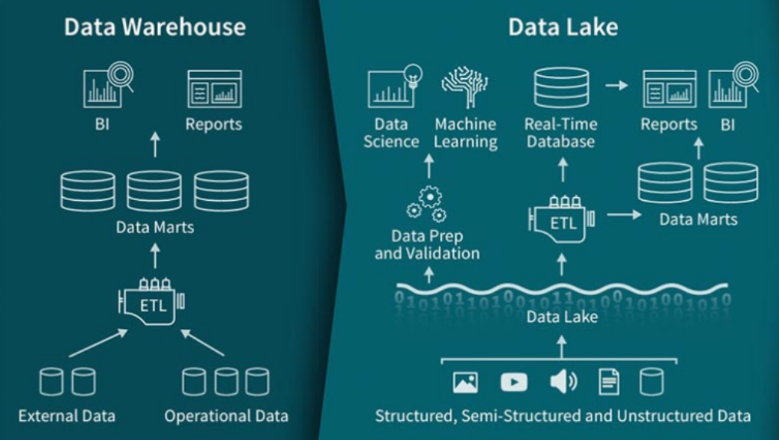
Data warehouse and Data Lake representation

Slide 22
Application-Orientation vs. Subject-Orientation
Application-Orientation
Subject-Orientation
Operational Database
Data
Warehouse
Credit
Card
Loans
Customer
Vendor
Product
Trust
Savings
Activity

Slide 23
Data warehouse Vs Data Marts Vs Data Lakes
Data Warehouse
Enterprise-wide
Industry follows E-R Model or Star schemas
Structure for corporate view of data
Data Mart
Departmental
Mostly Star Schema based (Facts and dimensions)
Quick turn around (up and running as there are less stakeholders)
Data Lakes
Big Data (HDFS) -- Hadoop
AWS S3 or Azure Object Storage
Store mostly unprocessed data in the data lakes
On consumption you do transformation (compute is heavy)

Slide 24
Data Transformation Terms
Extracting DATA from source
SQL, File Read, API Calls
Conditioning
Files (data type issue) US, APAC – mm/dd/yyyy, dd/mm/yyyy, dd-mon-yy
Scrubbing
Errors in spelling mistakes
BANGALORE, BENGALURU, BLR, BANGALURU
Merging
Merge two different sets of data
India sales, SL sales, BL Sales (+++)
House holding (Cluster)
Get HR Data (FT, Consultant, Intern, Others)
Aggregation
Sum, min, max, avg, mean, count
Rejection
Reject the invoices which are having amount = 0
Tax registration number is a must for regulation, if you don’t have the registration number, reject that data (error records)
Enrichment
City_name, state_name (ip)
(target – city_name, zipcode, state_name) (filling missing fields)
Scoring
Activity, process where you can grade a customer / employees / supplier. If cust is with you for more than 5 years then assing grade A, >2 years and < 5 years then assign B, >1 < 2 years then assing C, Else D
Deduplication – removing duplicate entries in the source data set.
Loading (SQL, File Write, HDFS, RedShift, Snowflake)
Validating – we reject data (accept / reject)
Delta – difference – incremental extract
We read all the timesheet data (up until yesterday) this morning. Tomorrow you get only the data which are new or modified rather than extracting full

Slide 25
Data Modeling for DW
DW Model
Normalization
(3rd NF)
De normalization
(Dimensional Modeling)
Completely normalized
Star Schema
Snow Flake
Completely de normalized
Partially de normalized

Slide 26
Tables – Retail Model
supplier
Country
Country_id
Country_nm
State
State_id
State_nm
State_capital
Country_id
City
City_id
City_nm
City_pop
State_id
Customer
Cust_id
Cust_name
City_id
Cust_dob
Cust_email
cust_gender
Store
Store_id
Store_code
Store_name
City_id
Product
Prod_id
Prod_code
Prod_cat
Prod_price
Prod_cost
Store_prod
Store_prod_id
Store_id
Prod_id
Commenced_on
Supplier
Sup_id
Sup_name
Sup_address
Sup_gst
City_id
Sales
Sales_id
Sales_date
Prod_id
Cust_id
Qty
Store_id
Store_dim
Store_id
Store_code
Store_name
City_name
State_name
Country_name
Supplier_dim
Sup_id
Sup_name
Sup_address
Sup_gst
City_name
State_name
Country_name
Customer_dim
Cust_id
Cust_name
Cust_dod
Cust_email
Cust_gender
City_name
State_name
Country_name
store
product
Sales
customer
payment
Calendar
Growth Analysis
Payment Analysis

Slide 27
Start Schema
store
product
supplier
Sales
order
customer
payment
Calendar

Slide 28
Populating Store Dimension Table
Country (4)
Country_id
Country_nm
State (10)
State_id
State_nm
State_capital
Country_id
City (20)
City_id
City_nm
City_pop
State_id
Python Code
(Data processing)
C_dataframe (country)
S_dateframe(state)
City_dataframe(city)
Store_dataframe (store)
Processed_Store_dataframe (45)
Insert into store_dim with the help of the data in processed store data frame
Store_dim (45)
Store_id
Store_code
Store_name
City_name
State_name
Country_name
Store (45)
Store_id
Store_code
Store_name
City_id

Slide 29
Dimension Tables
Dimension table attributes in the DW
Define business in terms already familiar to users
Wide rows with lots of descriptive text
Small tables (about a million rows)
Joined to fact table by a foreign key
heavily indexed
hierarchical elements exists in the dimensional
typical dimensions
time periods, geographic region (markets, cities), products, customers, salesperson, etc.

Slide 30
Employee (1 lakh employees) 1 year – timesheet table →
Emp_id
Emp_f_name,
l_name,
middle_name
Emp_dob
Emp_doj
Emp_address
Emp_city
Emp_zip
Emp_state
Emp_country
Emp_type
Emp_gender
Emp_designation
Emp_job
Emp_phone
Emp_email
Emp_ctc
Depart_name
Marital_status
Manager_name
Emp_work_location
Emp_degree
Emp_ethinicity
Timesheet
---------------
Time_sheet_id
Emp_id
Time_sheet_date
Proj_id
Working_hours
Country → States -- > City → Locations -- > Emp Name
Country → Department --> Emp_type --> City --> Emp Name

Slide 31
Calendar / Time Dimension
Cal_dim_id
Cal_date
Cal_Day
Cal_week
Cal_month
Cal_year
Cal_quarter
Fin_year
Fin_quarter
Week_day_flg
Payroll
---------------
Payroll_id
Emp_id
Cal_dim_id
BASIC HRA GROSS (measures)
Timesheet
---------------
Time_sheet_id
Emp_id
Cal_dim_id
Proj_id
Working_hours (measures)
Year → Quarter → Month → Week → Day

Slide 32
Tables in the 3rd NF Vs Dimensional
Master Tables
Detail Tables
Type tables
Transaction tables
Dimension Table
Fact Table
Emp_type
payroll
Employee
Period
dept
employee
Time
fact
Payroll
fact
Emp_projects
timesheet
Cust_type
Projects
customer
projects

Slide 33
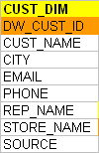
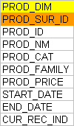
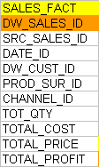
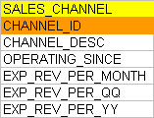
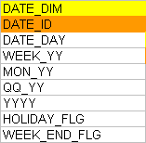
Star Schema -- Sales Analysis System

Slide 34
Slowly Changing Dimension
As discussed, over the period of time the master data gets changed in the source system. When that change happens, in DW we capture the same in one of the following ways.
TYPE 1 or SCD1
No history stored (We do this, if business does analysis based on the current data alone)
TYPE 2 or SCD2
Complete history stored. (when ever product price gets changed, the system should track it to see the price fall pattern)
We have to generate a unique key called surrogate ID’s in this type of tables
TYPE 3 or SCD3
Only current and previous values are stored.
We design the same in such a way that the current and previous values are stored in one physical key record. (storing customer_city and customer_pre_city)

Slide 35
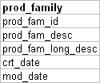
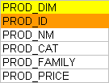
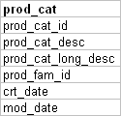

Type1 dimension
prod_dim1 (NO HISTORICAL / NO TRACKING CHANGES)
prod_id | prod_name | prod_price | prod_cost | pro_cat_desc | prod_family_desc
25 | PEN | 60 | 36 | Stationary | Office Supplies
26 | PENCIL | 35 | 28 | Stationary | Office Supplies
27 | Electronic Board | 4000 | 3000 | Electronics | Office Supplies
28 | Computer Table | 2500 | 1900 | Furniture | Office Supplies
29 | Paper Clip | 70 | 45 | Stationary | Office Supplies
prod_fam
prod_family_id | prod_family_desc
100 | Office Supplies
Step1: I will see how many records we have in the source (4 records)
Step2: I just created the type1 table, there are no records.
Read the data from the source table. (SQL – in the SP, Python).
In the programming language you hold the data.
To hold multiple records in the programming language – some variable
In PLSQL – Cursor variable
In Python -- ???
Print it…..
prod_cat
prod_cat_id | prod_cat_desc | prod_family_id
51 | Stationary | 100
52 | Electronics | 100
53 | Furniture | 100
Product
prod_id | prod_name | prod_price | prod_cost | prod_cat_id
25 | PEN | 60 | 36 | 51
26 | PENCIL | 35 | 28 | 51
27 | Electronic Board | 4000 | 3000 | 52
28 | Computer Table | 2500 | 1900 | 53
29 | Paper Clip | 70 | 45 | 51

Slide 36
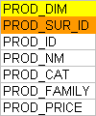
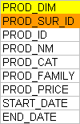
Type 2 (types of implementations)
Only with surrogate id
Storing changes with duration
With current record indicator

Slide 37
Type2 Data Visualization (tracking changes)
prod_fam
prod_family_id | prod_family_desc
100 | Office Supplies
prod_cat
prod_cat_id | prod_cat_desc | prod_family_id
51 | Stationary | 100
52 | Electronics | 100
53 | Furniture | 100
prod_dim2 (Historical changes -- track all the changes what happens in the OLTP)
prod_dim_key | prod_id | prod_name | prod_price | prod_cost | pro_cat_desc | prod_family_desc
100 | 25 | PEN | 60 | 36 | Stationary | Office Supplies
101 | 26 | PENCIL | 40 | 28 | Stationary | Office Supplies
102 | 27 | Electronic Board | 4000 | 3000 | Electronics | Office Supplies
103 | 28 | Computer Table | 2100 | 1900 | Furniture | Office Supplies
104 | 29 | Paper Clip | 55 | 35 | Furniture | Office Supplies
108 | 30 | Pen Holder | 100 | 80 | Stationary | Office Supplies
109 | 26 | PENCIL | 50 | 28 | Stationary | Office Supplies
110 | 31 | Wireless Mouse | 850 | 800 | Electronics | Office Supplies
product
prod_id | prod_name | prod_price | prod_cost | prod_cat_id
25 | PEN | 60 | 36 | 51
26 | PENCIL | 50 | 28 | 51
27 | Electronic Board | 4000 | 3000 | 52
28 | Computer Table | 2100 | 1900 | 53
29 | Paper Clip | 55 | 35 | 51
30 | Pen holder | 100 | 80 | 51
31 | Wireless Mouse | 850 | 800 | 52
Show me all the prod_names and the current price of the product

Slide 38
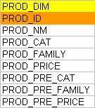
Type 3 (implementation)
prod_fam
prod_family_id | prod_family_desc
100 | Office Supplies
prod_id | prod_name | prod_price | prod_cost | pro_cat_desc | prod_family_desc | prod_pre_price | prod_pre_cost | prod_pre_name | pro_pre_cat | pro_pre_Family
25 | PEN | 55 | 36 | Stationary | Office Supplies | null | null | null | null | null
26 | PENCIL | 35 | 28 | Stationary | Office Supplies | null | null | null | null | null
27 | Electronic Board | 4250 | 3000 | Electronics | Office Supplies | null | null | null | null | null
28 | Computer Table | 3700 | 2100 | Furniture | Office Supplies | 3500 | null | null | null | null
prod_cat
prod_cat_id | prod_cat_desc | prod_family_id
51 | Stationary | 100
52 | Electronics | 100
53 | Furniture | 100
product
prod_id | prod_name | prod_price | prod_cost | prod_cat_id
25 | PEN | 55 | 36 | 51
26 | PENCIL | 35 | 28 | 51
27 | Electronic Board | 4250 | 3000 | 52
28 | Computer Table | 3700 | 2100 | 53

Slide 39
Keys and Surrogate Keys
A surrogate key is a unique identifier for data warehouse records that replaces source primary keys (business/natural keys)
Allow integration from multiple sources (each source system will have its own way of creating keys)
Track changes over time (e.g. new customer instances when addresses change)
Replace text keys with integers in both Dimension and Fact tables for efficiency
Scalability increases as we are protecting DW from data changes happens in source system.

Slide 40
Fact Table
Central table in the dimensional model
Most of the transaction tables in OLTP systems are considered as Fact table.
Mostly columns are numeric items
Narrow rows, a few columns at most
Large number of rows (millions to a billion)
Access via dimensions
All the dimension keys will be considered as FK.
In Retail, examples of fact tables are sales_fact, return_fact, purchase_order_fact, invoice_fact etc
In HRMS, you can consider payroll, timesheet, training_sessions are considered as the fact tables.
In the customer service application, outbound calls, inbound calls, service calls can be considered as fact tables.

Slide 41
Measure Types
Fully additive measure
Where we can apply any aggregate functions with any dimensions in that star schema
Semi additive measure
We wont be able to apply all aggregate functions in this type of column (Ex: percentage)
Non additive measure
We wont be able to apply any aggregate functions in this type of column (Ex: Tran_type = ‘S’ or ‘R’)
Sales_fact
Qty -- min, max, avg, count, sum →
Price_Per_Qty -- min, max, avg, count → making sense (sum → not making sense)
Discount
Profit_percentage -- sum (proft_percentage) → does not makes sense
Profit --
Amount -- Fully aggregate
Call center business
Call_id
Call_date
Customer
Case_type
Comment (…….) – these kind of measures in the fact table is called as non additive measure

Slide 42
Fact Less Fact tables
Usually fact table has all the measures through which you measure the performance of the business.
Typical fact table has qty, cost, price, discount, margin columns where you can apply aggregate functions.
In some cases, we wont be having these kind of measures ex: any event tracking DW
Web click analysis, attendance system etc are the examples
Website, User, Time, Page (Dim)
Webclick_id, website_id, user_id, period_id, page_id (webclick_fact)
Employee, time, subject, student, schedule
att_id, employee_id, time_id, sub_id, stud_id, sche_id (att_fact)
fee_id, stud_id, time_id, course_id, amount (Fee_fact) - fact tables with measures
In the above mentioned systems, the existence of the record becomes the fact. So in web click analysis the combination of user, date and webpage is the fact.

Slide 43
Sales, Return and Purchase Star schema
Supplier
dim
Cust
dim
prod
dim
return_fact
Purchase_order
Sales_fact
period
dim
store
dim
Confirmed Dimension --

Slide 44
Snow flake Schema
Snow flake won’t have much of redundant data as most of the dimensions will have a look table.
This way the number of joins between the tables will become more, which may impact the performance of the queries.
Even in snow flake we will have the dimensions and facts only. Only difference is we normalize the dimension table based on the hierarchy.
A dimension has minimum of one hierarchy. Some of the dimensions can have multiple hierarchy.
Both have advantages and dis advantages, so analyze the end user’s requirements and space constraints to pick the best.
If the storage is a constraint, you can go with snow flake schema. Snow flake takes less storage space compared to Star Schema.

Slide 45
The Snowflake Schema
Store Dimension
STORE KEY
District_ID
Region_ID
Store Description
City
District ID
State
District Desc.
Region_ID
Region Desc.
Regional Mgr.
Store Fact Table
STORE KEY
PRODUCT KEY
PERIOD KEY
Dollars
Units
Price
Notes:
Notice how the Store dimension table generates subsets of records. First, all records from the table (where level = ìDistrictî in the Star) are extracted, and only those attributes that refer to that level (District Description, for example) and the keys of the parent hierarchy (Region_ID) are included in the table. Though the tables are subsets, it is absolutely critical that column names are the same throughout the schema.
The diagram above is a partial schema - it only shows the ìsnowflakingî of one dimension. In fact, the product and time dimensions would be similarly decomposed as follows:
Product - product -> brand -> manufacturer (color and size are extended attribute characteristics of the attribute ìproduct,î not part of the attribute hierarchy)
Time - day -> month -> quarter -> year

Slide 46
Period dimension
Cal_month_id (PK)
Cal_month_name
Cal_quarter_id
Date_id
Cal_date
Cal_year
Cal_month
Cal_month_no
Cal_short_month
Cal_ww cal_qq cal_day
Cal_week_day_flg
Fin_year
Fin_quarter
Fin_month
Season
Cal_week_id
Cal_date
Cal_week
Cal_month_id (FK)
Date_id
Cal_date
Cal_year
Cal_month
Cal_month_no
Cal_short_month
Cal_week_id cal_qq cal_day
Cal_week_day_flg
Fin_year
Fin_quarter
Fin_month
Season
Weekly_sales
Week_id

Slide 47
Snow flake - Insurance model
Cat_lookup
org_dim
Cat_id
Cat_desc
cust_dim
State_lookup
Org_id
Name
Cat_id
Manager_nm
txn_fact
Cust_id
Name
Address
Phone
State_id
State_id
State_desc
dept_lookup
Org_id
Emp_id
Cust_id
Policy_id
Cal_date_id
Payment_amt
Claims_amt
emp_dim
Dept_id
Dept_name
Emp_id
Ename
Join date
Sal
Dept_id
policy_dim
Policy_id
Name
Start_date
End_date
Year_lookup
Quarter_lookup
Year_id
year
Quarter_id
Quarter
Year_id
month_lookup
Week_lookup
Cal_dim
Month_id
Cal_month
Quarter_id
Week_id
Cal_week
Month_id
Cal_date_id
Date
Week_id

Slide 48
Star Schema Vs Snowflake schema
Store_dim
Store_id
Store_code
Store_name
City_name
State_name
Country_name
Supplier_dim
Sup_id
Sup_name
Sup_address
Sup_gst
City_name
State_name
Country_name
Customer_dim
Cust_id
Cust_name
Cust_dod
Cust_email
Cust_gender
City_name
State_name
Country_name
Store_dim
Store_id
Store_code
Store_name
City_id
Supplier_dim
Sup_id
Sup_name
Sup_address
Sup_gst
city_id
Customer_dim
Cust_id
Cust_name
Cust_dod
Cust_email
Cust_gender
City_id
City_lookup
city_id
City_name
City_popu
City_mayor
State_id (FK)
State_lookup
State_id (PK)
State_name
Country_id
Country_lookup
Country_id (PK)
Country_name
Star Schema Dimension Tables
Snow flake Schema Dimension Tables

Slide 49
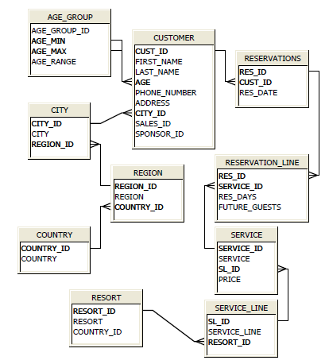
OLTP Model of resort
OLAP Model of resort
Calendar_dim
----------------------
Cal_date
Cal_week
Cal_day
Cal_month
Cal_quarter
Cal_year
service_dim
-----------------
Service_id
Serice_name service_line
Resort_name
Country_name
Reservation_fact
----------------------
Res_id
Cust_id
Res_date
Service_id
Res_days
Number_of_guests
Price_of_service Reservation_revenue
Customer_dim
--------------------
Cust_id
Cust_f_name
Cust_l_name
Age_range
Phone_number
Address
City_name
Region_name
Country_name
Create Views to replicate the star schema based on the OLTP Model.
When those views performance is bad, then we convert those views into materialized views

Slide 50
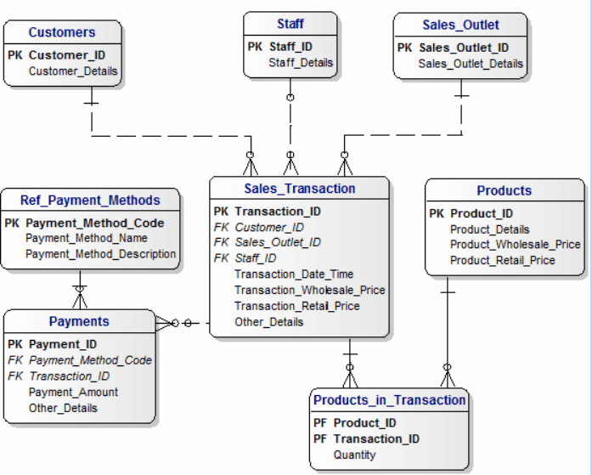
OLTP System – Retail Data Model

Slide 51
Retail Data Model – Visualizing the number of records
80
20
20000
300 * 20 * 365 * 4
6
200
300 * 20 * 365 * 4 + 60000
300 * 20 * 365 * 4 * 3

Slide 52
Star Schema with sales fact and payment fact
EMPLOYEE
STORE_DIM
CUSTOMER
SALES_FACT
FACT_ID
TXN_ID
STORE_ID
EMP_ID
CUST_ID
CAL_ID
PRO_ID
QTY
WHOLE_PRICE
RETAIL_PRCE
PAYMENT_TXNS
PAYMENT_METHOD_DIM
CALENENDER_DIM
PROD_DIM_TYPE2

Slide 53
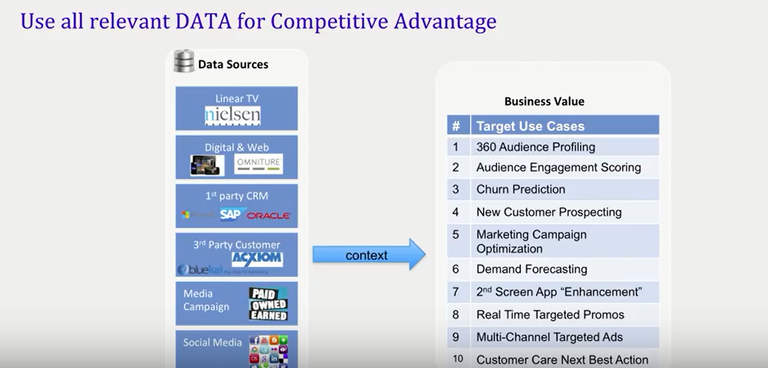
What customers expect from consolidating data in one place

Slide 54
What is OLAP?
What is OLAP?
Online Analytical Processing.
Viewing data in a multi dimensional way.
Why OLAP?
“Slice and dice” for data warehouse.
OLAP is a multi dimensional way of storing / viewing the data
RDBMS is a 2 dimensional way of storing / viewing the data

Slide 55
Types in OLAP?
Three types of OLAP in the industry.
ROLAP – Relational OLAP
Business Objects
Microstrategy
PowerBI can get data from RDBMS
MOLAP – Multi dimensional OLAP
SSAS Cubes,
Oracle Essbase,
Cognos Cubes.
PowerBI can get data from MOLAP
HOLAP – Hybrid OLAP

Slide 56
Architecture diagram of ROLAP
App Server
ROLAP tools
Like
BO
Cognos
Microstrategy
Etc
BI Metadata
Data Warehouse
/
Data Mart
/
Or Data Lake
OLAP
Report1
OLAP
Report2
OLAP
Report n
When a report is executed by end user the actual SQL is issued to RDBMS to get the data. Some BI tools can even store the results set in the application server and periodically refresh that report based on the data refreshes which happen in DW.

Slide 57
OLAP functionality
Drill down (state -> City -> Customer -> Account
Drill Up ( Customer -> City -> State
Drill through (City -> Customer -> Product name)
Drill Across (City -> Customer sales -> web clicks )
Time
Dimension
product
dimension
sales
fact
Web click
fact
Customer
dimension

Slide 58
Architecture of MOLAP
OLAP
Report1
Microsoft
Analysis
Services
BI Metadata
Cube defn
etc
MOLAP
cubes
DataWarehouse
Or
Data Mart
OLAP
Report2
MOLAP
cubes
OLAP
Report n
When a report is executed by end user the actual data is retrieved from the MOLAP cubes. The way it retrieves by using MDX queries based on the report. MDX stands for Multidimensional expression. SQL is used to get the data RDBMS, MDX is used to get the data from MOLAP. The MOLAP cubes are refreshed periodically based on the data refreshes which happen in DW.

Slide 59
Terminology
Cube –
A cube is a multidimensional structure of data. Cubes are defined by a set of dimensions and measures.
Notes:
Points
Click – Measures – numeric details that are used in calculations (Sales revenue, number of units)
Click – Members - attributes of a measure that help describe a measure (Jan, Feb, Mar, red, blue, green)
Click - Levels - a group of like members (Month, Colors)
Click – Dimensions – a structure that organizes levels into a hierarchy (Time)
Click – Cube - is a logical collection of Measures and Dimensions (levels and members)
Narrative
In order to get off to a solid start, let’s take a couple of minutes to define some of the basic terminology.
Click
Measures are the numeric data of interest such as number of items and revenue per sale. Measures are typically used in arithmetic functions so that we can explore how they behave when grouped differently or to derive other measures. Measures are taken from the fact table of a star or snowflake schema.
Click
Members represent data within a dimension’s level. For example, January is a member of the Month level in the Time dimension
Dimensions provides a hierarchical organization to its members. For example Time can be measured in a hierarchy of Months, Weeks, Days, and so on. These are called levels and are ordered from least granular (Year) to most granular (Day).
Click
Cubes are the containers for measures, dimensions, aggregations, and partitions. Cubes are based on a single fact table.
A cube can contain up to 63 dimensions (actually 64, here’s a hint for more advanced users, measures are frequently referenced as members of a dimension).

Slide 60
Terminology
Location
Dimension –
A structural attribute of a cube that acts as an index for identifying values within a multi-dimensional array.
If all dimensions have a single member selected, then a single cell is defined.
Products
Time
Notes:
Points
Click – Measures – numeric details that are used in calculations (Sales revenue, number of units)
Click – Members - attributes of a measure that help describe a measure (Jan, Feb, Mar, red, blue, green)
Click - Levels - a group of like members (Month, Colors)
Click – Dimensions – a structure that organizes levels into a hierarchy (Time)
Click – Cube - is a logical collection of Measures and Dimensions (levels and members)
Narrative
In order to get off to a solid start, let’s take a couple of minutes to define some of the basic terminology.
Click
Measures are the numeric data of interest such as number of items and revenue per sale. Measures are typically used in arithmetic functions so that we can explore how they behave when grouped differently or to derive other measures. Measures are taken from the fact table of a star or snowflake schema.
Click
Members represent data within a dimension’s level. For example, January is a member of the Month level in the Time dimension
Dimensions provides a hierarchical organization to its members. For example Time can be measured in a hierarchy of Months, Weeks, Days, and so on. These are called levels and are ordered from least granular (Year) to most granular (Day).
Click
Cubes are the containers for measures, dimensions, aggregations, and partitions. Cubes are based on a single fact table.
A cube can contain up to 63 dimensions (actually 64, here’s a hint for more advanced users, measures are frequently referenced as members of a dimension).

Slide 61
Terminology
Location
China
Peru
Japan
Italy
Measures –
Numeric data of interest.
e.g. Revenue per Sale, Quantity
Coffee
Apples
Tea
Onions
Products
€1.95
January
February
March
April
Time
Notes:
Points
Click – Measures – numeric details that are used in calculations (Sales revenue, number of units)
Click – Members - attributes of a measure that help describe a measure (Jan, Feb, Mar, red, blue, green)
Click - Levels - a group of like members (Month, Colors)
Click – Dimensions – a structure that organizes levels into a hierarchy (Time)
Click – Cube - is a logical collection of Measures and Dimensions (levels and members)
Narrative
In order to get off to a solid start, let’s take a couple of minutes to define some of the basic terminology.
Click
Measures are the numeric data of interest such as number of items and revenue per sale. Measures are typically used in arithmetic functions so that we can explore how they behave when grouped differently or to derive other measures. Measures are taken from the fact table of a star or snowflake schema.
Click
Members represent data within a dimension’s level. For example, January is a member of the Month level in the Time dimension
Dimensions provides a hierarchical organization to its members. For example Time can be measured in a hierarchy of Months, Weeks, Days, and so on. These are called levels and are ordered from least granular (Year) to most granular (Day).
Click
Cubes are the containers for measures, dimensions, aggregations, and partitions. Cubes are based on a single fact table.
A cube can contain up to 63 dimensions (actually 64, here’s a hint for more advanced users, measures are frequently referenced as members of a dimension).

Slide 62
Bank Scenario --- what is your project ( Credit card fraud deduction ) --
Source data1
100 80 75 70
Target
Source data2
20
5
5

Slide 63
ODS – Operational Data Store
Weekly Level KPI + Daily Level KPI
CRM
DW
(weekly data only)
Cal_dim
Cust_dim
Emp_dim
Prod_dim
Sales_order_fact
Daily load
Daily
(near real time compared to DW)
HRMS
Sales Orders
Weekly level KPI
Weekly load

